Slide 1
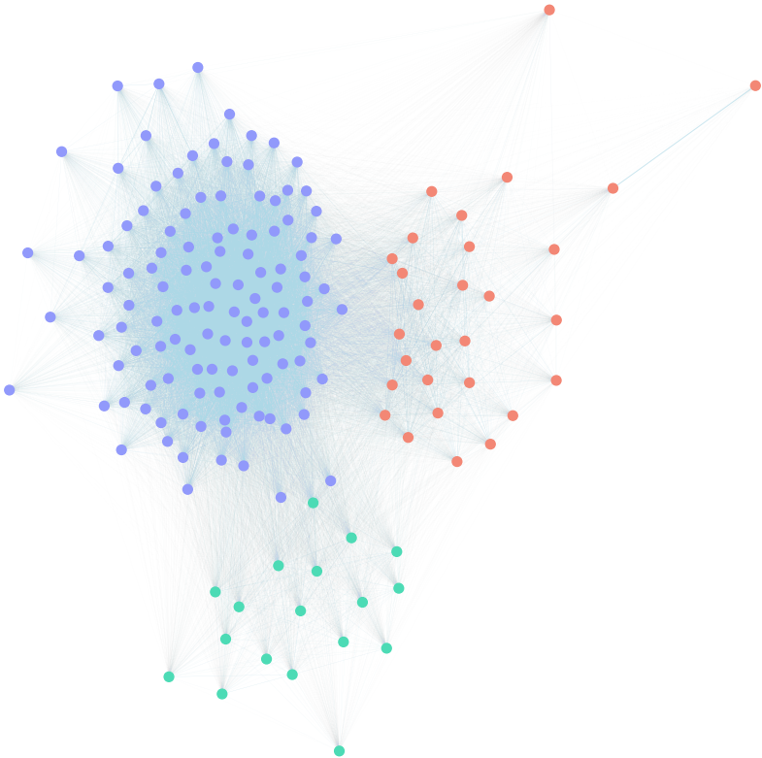
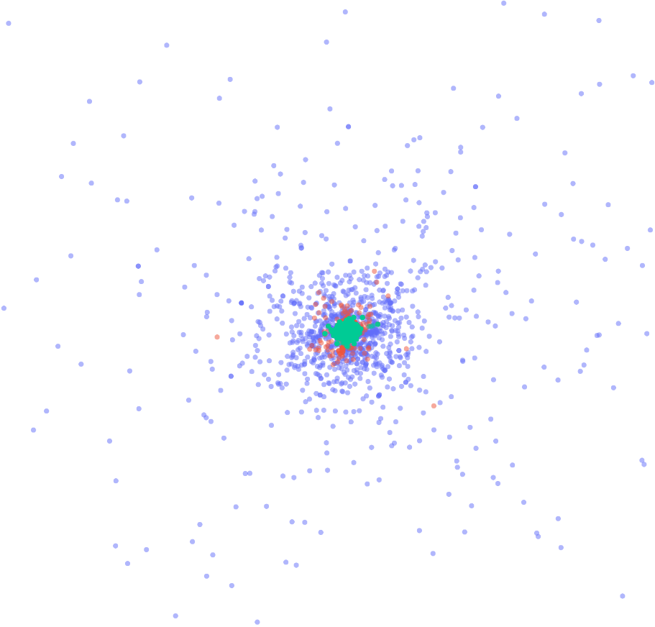
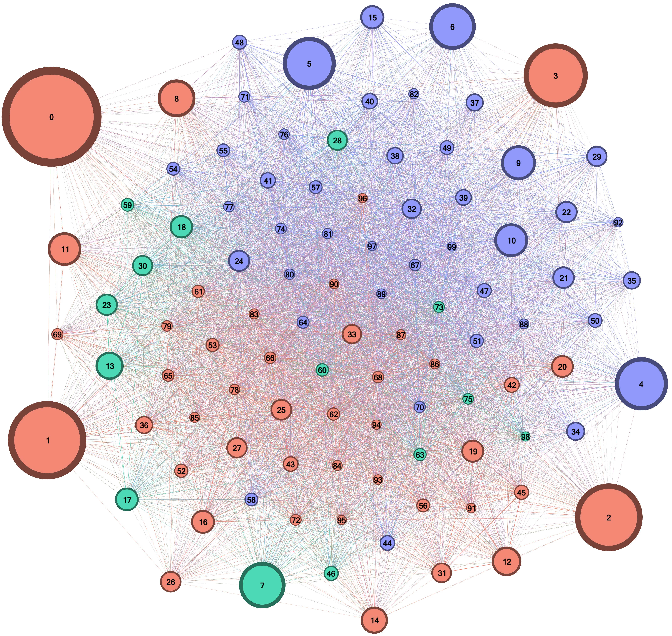



Incels affiliation with Alt-right using Neural Topic Modeling
Final project for Network Science, A.Y. 2022/23 A. Gobbin, G. Nagaro, D. Ninni, L. Valentini

Slide 2
Preliminary results | datasets
Using 4 small datasets:
Alt-right dataset: 200k entries
Left-wing dataset : 200k entries
Incel dataset : 200k entries
A combined dataset: union of the three specific ones : 600k entries
Having less data but more flexibility.

Slide 3
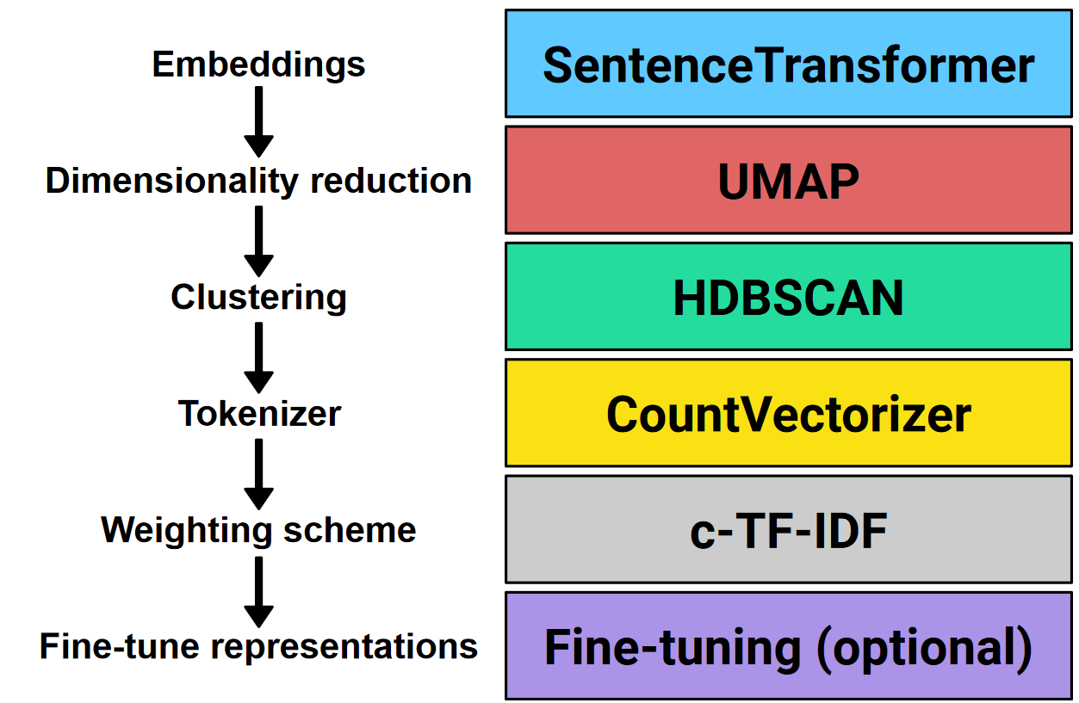
Preliminary results | BERTopic
PCA and regularization to reduce the complexity
Fine Tuning, including different vectorizers and different choices of stopwords

Slide 4
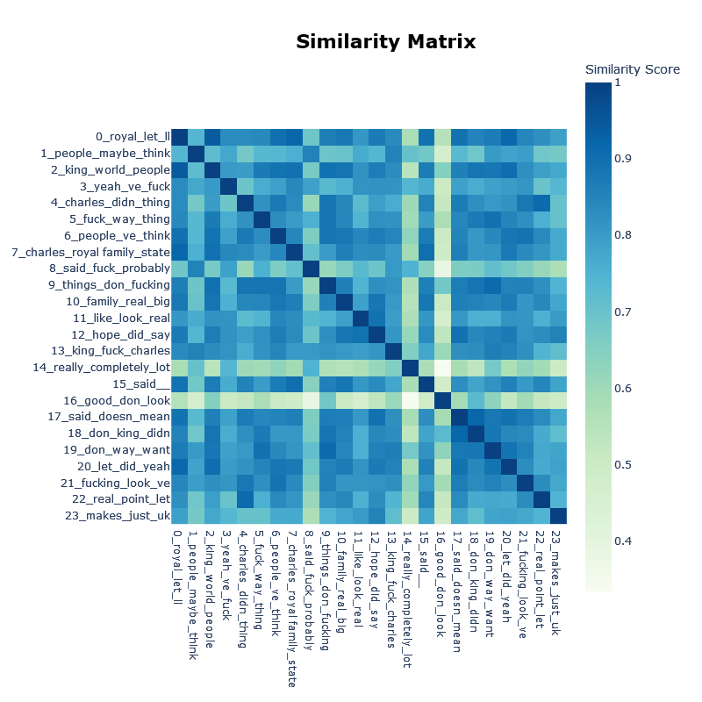
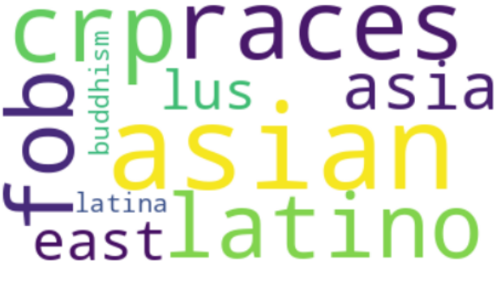
Preliminary results | Extracting topics

Slide 5
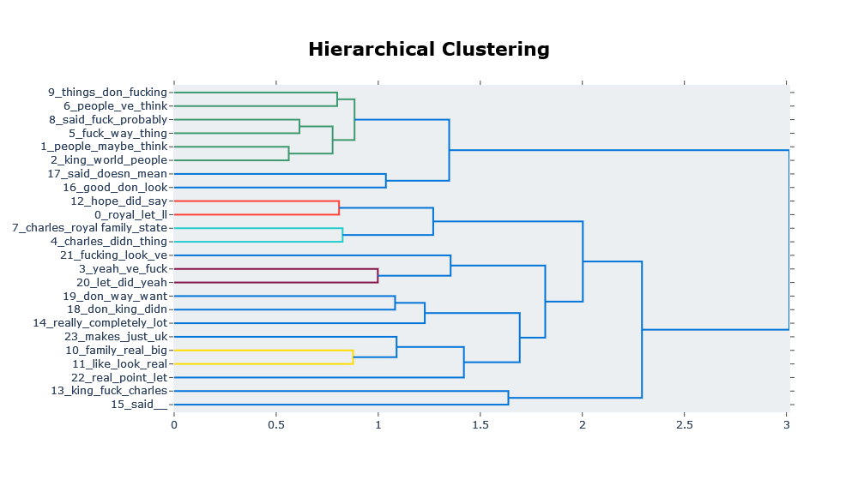
Preliminary results | Extracting topics

Slide 6
Preliminary results | Extracting topics
Updating and reducing the number of topics to apply the new parameters without computing again the whole model.
Hyperparameters fine tuning:
ngram_range = (1, 2)
top_n_words = 10
min_topic_sized = 500
all-MiniLM-L6-v2 as sentence transformer model
Stopwords specifically hand picked a posteriori

Slide 7
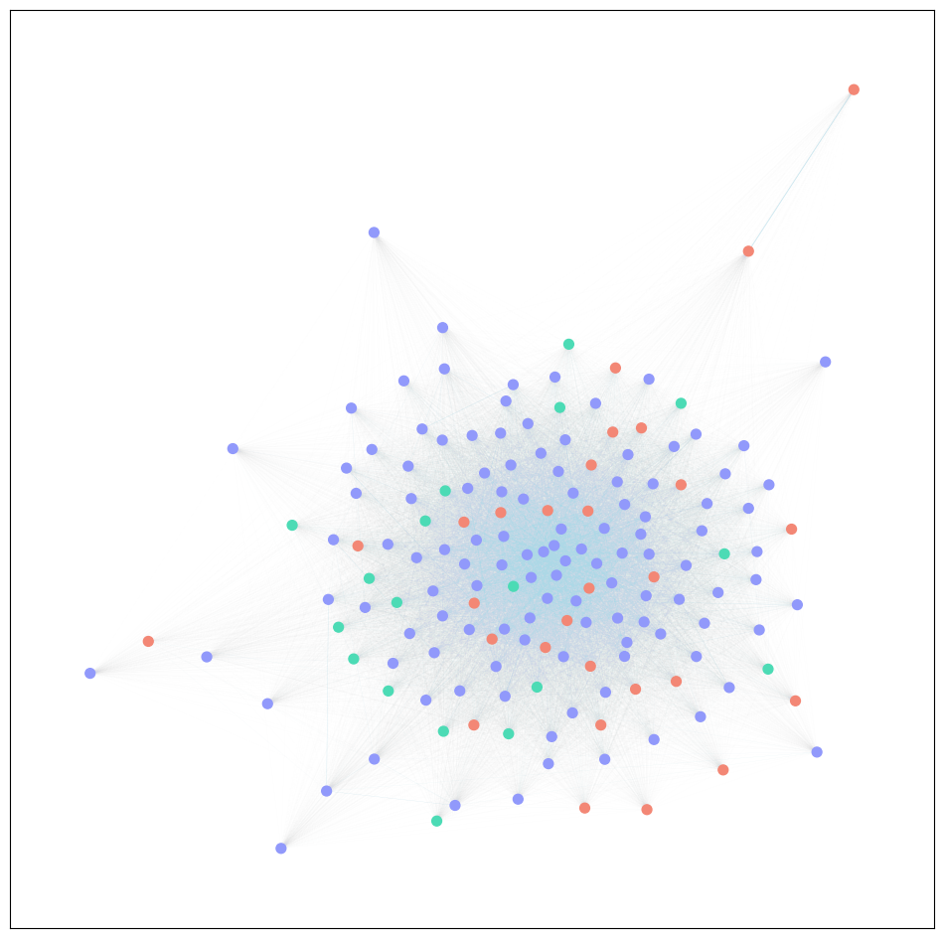
PRELIMINARY RESULTS | Tagging & Visualization
Tags each topic as Incel, Alt-Right or Leftwing
First one found Algorithm

Slide 8
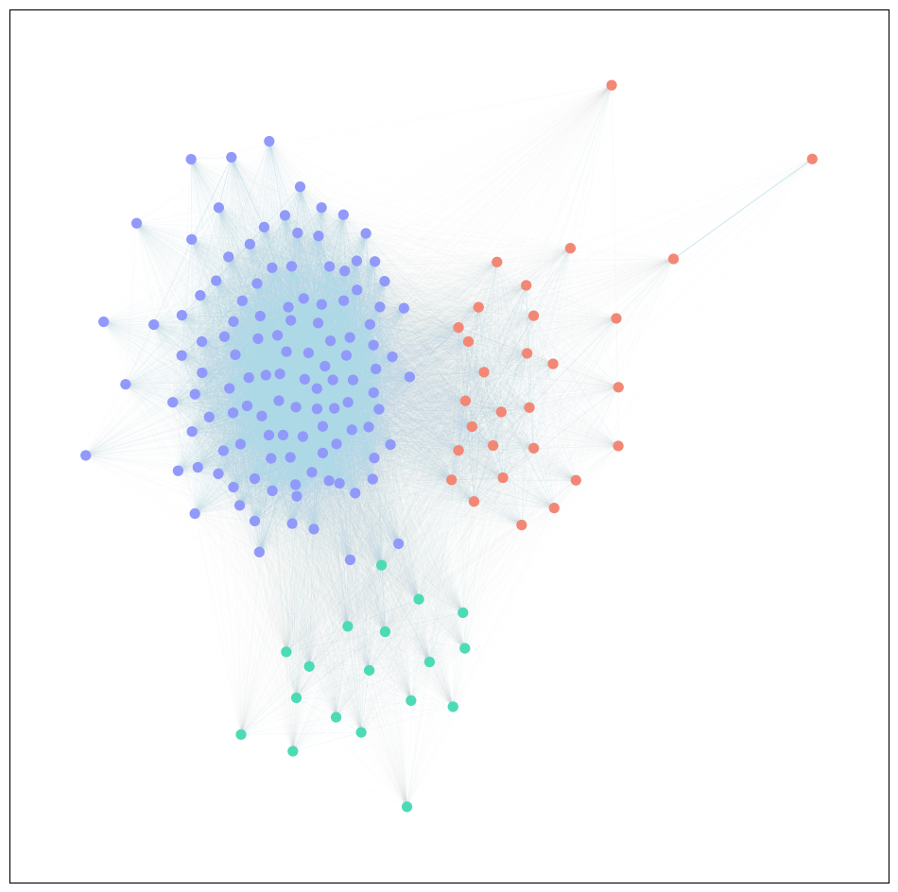
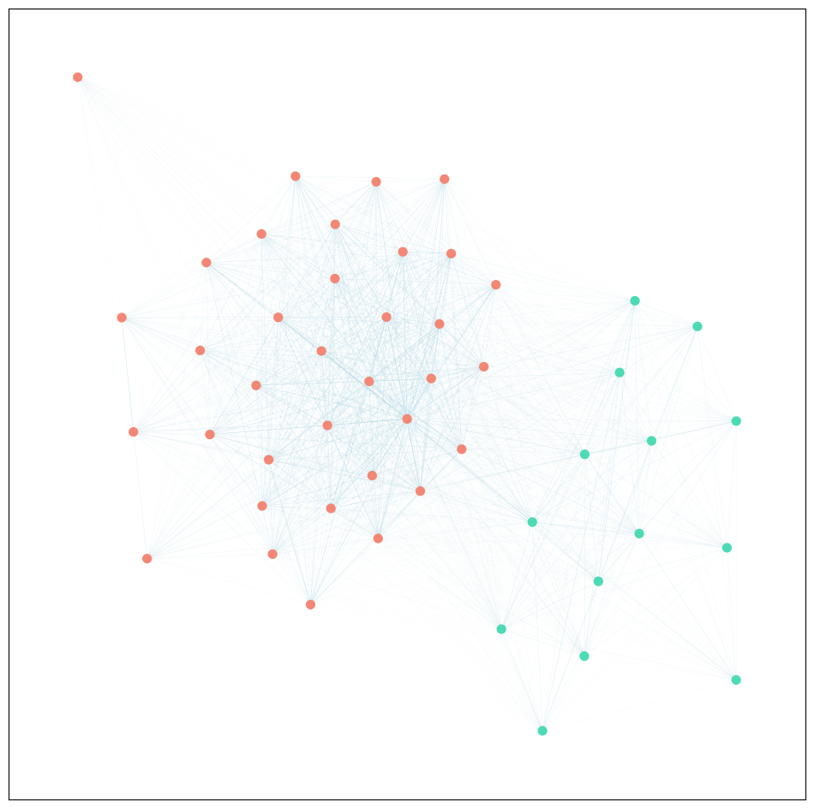
PRELIMINARY RESULTS | Numeric Results
average weight | incels | alt-right | left-wing
incels | 0.107 | 0.069 | 0.070
alt-right | 0.069 | 0.105 | 0.063
left-wing | 0.070 | 0.063 | 0.078
average weight | alt-right | left-wing
alt-right | 0.175 | 0.080
left-wing | 0.080 | 0.136

Slide 9
Conclusions
Deep connections between incels and political debate.
Weak differences comparing the connections with right and left wing parties.
The results are coherent with the ones of other studies.
Possible improvements of this work could come from the use of more advanced language models, which would allow a more specific analysis of social network content.

Slide 10

Thank you!
Alberto Gobbin
Gianmarco Nagaro Quiroz
Daniele Ninni
Lorenzo Valentini

